Slide 1
CPM, PERT & Schedule Risk Analysis in Construction
Pedram Daneshmand
MConstMgmt, MEngSc, BEng (Civil)
MIEAust

Slide 2
Introduction
Program Risk Management System
System Safety Analysis
Uncertainty Quantification
Objective: Quantification / Presentation of Time required to achieve a business objective
Techniques for Schedule Analysis in Construction
  CPM (CPA), PERT, Monte Carlo Simulation Method
Construction Feasibility Management Case Study

Slide 3
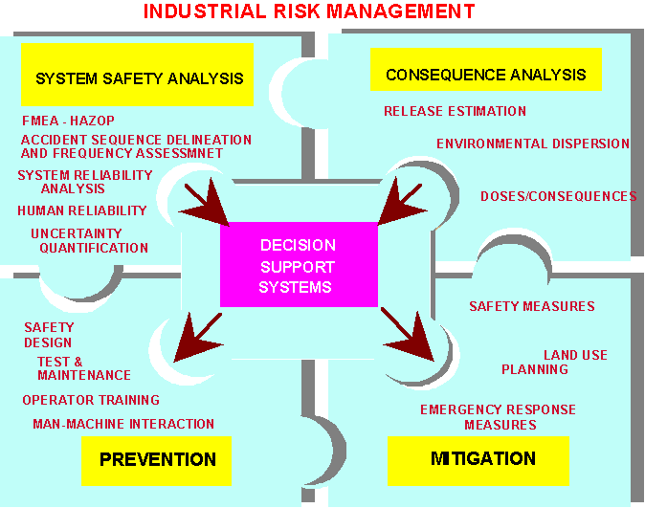
Program Risk Management System

Slide 4
System Safety Analysis
FMEA: Failure Modes and Effects Analysis is a methodology for analyzing potential reliability problems early in the development cycle when it is easier to take actions to overcome these issues, thereby enhancing reliability through design.
Accident Frequency Assessment
System Reliability Analysis
Human Reliability
Uncertainty Quantification

Slide 5
Uncertainty Analysis Approaches
Decision Trees
Linear Programming
Line of Balance
PERT
Monte Carlo Simulation Method

Slide 6
Monte Carlo Simulation Advantages
Examine more than one Critical Path (CPM)
Accurate
  Overall Duration Distribution
  Confidence Interval (Accuracy Range)
Opportunity for Sensitivity Analysis
Varied Activity Distribution Types – Not just Beta
Schedule logic can include branching: Probabilistic and Conditional
If resources loaded, analysis integrates schedule and cost.

Slide 7
Monte Carlo Simulation Outputs
Tabular Statistical Data
  Activity listings showing:
    Start & Finish Date Ranges
    Duration Ranges
    Number of times and/or percent Critical
    Criticality Distribution Profile
    Major Critical Path reports
    Three point estimates typically mark out the range of outcomes from the 5th to the 95th percentiles. If estimates are accurate, then only 5% of the activities or risk events should fall beyond the pessimistic points.

Slide 8
Feasibility Management Case Study
Case Study:
  Building Engineering Services Feasibility Studies on various Telephone Exchanges included:
    Identify non-compliance with client’s Fire Safety Manual
    Identify non-compliance with client’s standards
    Identify available capacity
    Identify Critical Elements in services
    Increase system reliability and availability

Slide 9
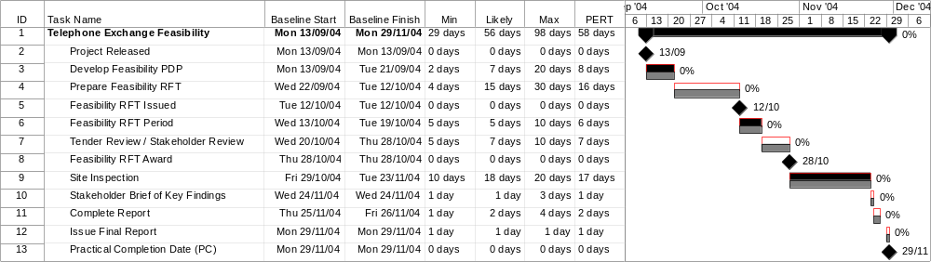
CPM and PERT Methods
CPM: Likely task Durations
PERT: Optimistic, Likely and Pessimistic Durations
Schedule MSP layout based on CPM & PERT

Slide 10
Schedule Risk Analysis Methodology
Definition of Project Identifications
Risk Definition
Create CPM and/or PERT Output
Uncertainty Estimation
Schedule Risk Analysis Performance
(Monte Carlo Simulation)
Sensitivity Risk Analysis Performance
Assumptions Re-consideration

Slide 11
Outputs
Subject Telephone Exchange
Entire Plan: Finish Date
100%
11/Jan/05
Analysis
Simulation:
Latin Hypercube
95%
23/Dec/04
Iterations:
1000
125
90%
21/Dec/04
Convergence
85%
16/Dec/04
Plan Finish Date:
80%
15/Dec/04
Converged in 200 iterations
75%
14/Dec/04
(Variation < 1% over 100 iterations)
100
Total Plan Cost:
70%
10/Dec/04
Converged in 200 iterations
65%
09/Dec/04
(variation < 1% over 100 iterations)
60%
08/Dec/04
Statistics
Minimum:
02/Nov/04
55%
Cumulative Frequency
Hits
75
07/Dec/04
Maximum:
11/Jan/05
50%
06/Dec/04
Mean:
05/Dec/04
45%
03/Dec/04
Max Hits:
140
40%
02/Dec/04
Standard Deviation:
11.56
50
35%
01/Dec/04
Selected Confidence
80%:
15/Dec/04
30%
29/Nov/04
Deterministic Finish:
29/Nov/04
25%
26/Nov/04
Probability
30%
25
20%
25/Nov/04
15%
24/Nov/04
10%
22/Nov/04
0
5%
17/Nov/04
02/Nov/04
19/Nov/04
06/Dec/04
23/Dec/04
09/Jan/05
Distribution (start of interval)

Slide 12
Conclusion/Suggestions
We reached 140 Max Hits when Std Deviation was 11.56 and Min and Max PPC Dates were 02/Nov/04 and 11/Jan/05 respectively.
Deterministic Finish Probability for PPC is just 30%.
PERT Finish Probability for PPC is about 35%.
Schedule Risk Analysis suggests the 80% probability for PPC Date.
Output illustrates the probability of different PPC Dates.
Project modeled with Triangle Distribution. Beta Pert Distribution can be considered for future analysis.
Analyze similar to Cost Risk Analysis.
Duration Sensitivity Risk Analysis should support the data.
Further study into the Confidence Levels is required.

Slide 13
More Risks … More Achievements
Less Risks … More Safety
Answer : Risk Management.

